Slide 1
Approaches to Statistical Analysis:Reporting Estimates and Confidence Intervals
David Schottenfeld M.D. M.Sc.
Epidemiology 655
Winter Term 1999

Slide 2
Accuracy of Measurements of Characteristics of Sample
Measurement Error: Amount of variation associated with measurement technique
Sampling Error: Size and representativeness
Random Error: Inherent biologic variation

Slide 3
Significance Testing/Hypothesis Testing
Could chance or random error have resulted in the measured association?

Slide 4
Approaches to Statistical Analysis
Estimation of magnitude of association
Risk Ratio
Rate Ratio
Odds Ratio
Confidence Interval: Range of values, consistent with data that is believed to encompass the “true” population parameter
How precise is the estimate?

Slide 5
Confidence Intervals (CI’s) can be derived:
differences between group means, mean changes in group over time
proportions
Odds ratios
Rate ratios, risk ratios
Survival rates
Slopes of regression lines
Coefficients in regression models
Report upper and lower values of CI, (95%CI: lower limit, upper limit)

Slide 6
The mean plus and minus standard error of the mean is about a 68% CI. The more conservative 95% CI is included in the mean±1.96 (S.E. of mean)
Thus: 32 of 100 similar studies will likely produce a mean value outside the range identified by a 68% CI; whereas only 5 of 100 similar studies will likely produce a mean value outside the range identified by a 95% CI.
Note: A logarithmic transformation is often used for data which is skewed positively to the right, and thus approximation to normal distribution is greatly improved. (Generally use Ln transformation

Slide 7
Mean value on transformed log scale can then be back transformed by taking antilog~ geometric mean. Calculation of standard deviation on log transformed data requires taking difference between each log observation and log geometric mean. To get back to the original scale, take antilog of CI’s on log scale to give 95% CI for geometric mean on original scale

Slide 8
Approaches to statistical analysis
Identify statistical test used in each comparison
Cite reference for complex or uncommon statistical tests used to analyze data
Specify whether test is one tailed or two -tailed (alpha level, P-value)
Report apriori power calculation in methods section
Specify use of test for unpaired (independent) or paired (matched) data

Slide 9
Cases Controls Total
E a b m1
E c d m2
Total n1 n2 N
Approximate CI for odds ratio by Cornfield
Corresponds to Fisher’s exact test of significance of association in 2*2 table.
All marginal totals in table are considered to be fixed (n1, n2, m1, m2)
OR (lower CL) = aL (n2-m1+aL) / (m1-aL)(n1-aL)
OR (upper CL) = au (n2-m1+au) / (m1-au)(n1-au)

Slide 10
Cases Controls Total
E a b m1
E c d m2
Total n1 n2 N
Approximate CI for odds ratio by Cornfield
Corresponds to Fisher’s exact test of significance of association in 2*2 table.
All marginal totals in table are considered to be fixed (n1, n2, m1, m2)
OR (lower CL) = aL (n2-m1+aL) / (m1-aL)(n1-aL)
OR (upper CL) = au (n2-m1+au) / (m1-au)(n1-au)

Slide 11
Use of oral estrogens for endometrial cancer cases and controls
Estrogens Cancer Controls Total
Yes 55 19 74
No 128 164 292
Total 183 183 366
Iterative calculation of al and au based on Cornfields method for approximate confidence limits on Odds ratio
Iteration aL Au
1 47.766 62.234
2 47.237 61.275
3 47.211 61.437
… …
7 61.414

Slide 12
Reference statistical packages or programs used to analyze data:
Epi-info
SAS
BMDP
S Plus
SPSS
Stat Xact
Systat
Minitab
Egret

Slide 13
Report any outlying values and how they were treated in the analysis
Confirm that assumptions of test have been met
normally distributed
group variances equal
independent samples
randomly selected
transformation of data
For chi-square test, confirm that expected count in each cell(not observed count) greater than 5 or that an “Exact” testing procedure was used

Slide 14
Report 95% CI , report actual P-value to two significant digits
When using Student’s T test, ANOVA, F-test, Chi-square test, specify degrees of freedom.

Slide 15
Flowchart 1 Bivariable analysis of a continuous dependent variable.

Slide 16
Flowchart 2 Bivariable analysis of an ordinal dependent variable

Slide 17
Flowchart 3 Bivariable analysis of a nominal dependent variable

Slide 18
Flowchart 4 Multivariable analysis of a nominal dependent variable.

Slide 19
What do we mean by “trend”?
Trend implies that one variable changes in a constant direction relative to another variable; it may not necessarily imply that the degree of change is constant.
The slope of a regression equation indicates the direction of the relationship ( + or -) and the quantity by which the mean of the dependent variable changes for each unit change in value of independent variable
When dependent variable is nominal, we are interested in how probabilities change for each unit change in value of independent variable

Slide 20
Assumption that mathematical relationship is a straight line?
i.e. probability of outcome event (dependent variable) changing at constant rate with each unit change in value of independent variable

Slide 21
Chi-square test for trend
For a continuous dependent variable, null hypothesis was tested by examining ratio:
regression mean square / residual mean square=F-ratio
*regression mean square=explained variation of dependent variable / d.f.
residual mean square=unexplained variation of dependent variable / d.f.
Chi-square test for trend: ∑n_{i} (p_{i} - p)² / p(1-p)
*For nominal dependent variable with one degree of freedom
*Note: the square root of the χ² ratio is equivalent to student’s t-test with infinite degrees of freedom

Slide 22
The chi square test for trend equation is equivalent to regression sum of squares / overall probability of event (p) x(1-p)

Slide 23
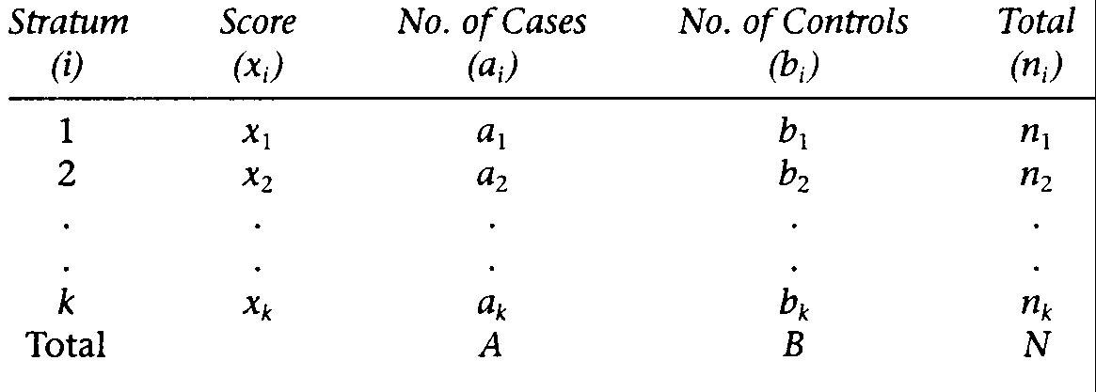
Mantel Test for Trend Multiple Ordinal Categories

Slide 24
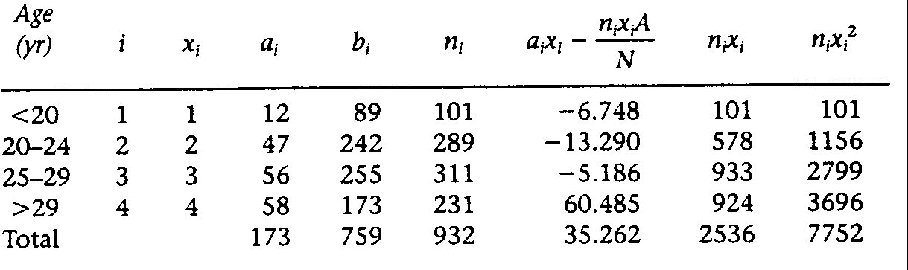
Mantel’s Trend Test
Source: Data from Am J Epid Vol 128, pp 431-438

Slide 25
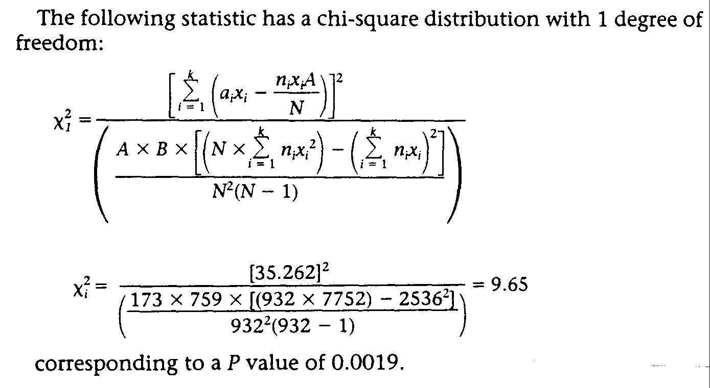

Slide 26
Principles of Matching

Slide 27
Controlling for Confounding
Randomization
Restrictive Sampling
Matching
Stratification
Multivariate Analysis

Slide 28
Magnitude of Confounding by a covariate(risk factor) will be dependent on:
Strength of the association of the risk factor with the disease among cases, and controls, who have not experienced principal exposure under investigation
Strength of association of risk factor with the principal exposure among the controls

Slide 29
Prevalence of the risk factor (Note: as a general rule, substantial confounding does not occur when the prevalence of the “confounder” is very low (<5%) or very high (>95%).
Unless the confounding covariate is a major risk factor for the disease (e.g. smoking and lung cancer) and very common (e.g. 40-50%), the confounded odds ratio will rarely overestimate (or underestimate) true odds ratio by more than a factor of 2

Slide 30
Types of Matching
Individual matching: subject by subject as in a case-control study, one or more controls matched on age, gender, race to each case
Frequency matching (category matching): Selection of an entire stratum of reference subjects with matching by risk factor values equal to that stratum of cases (e.g. white females, 40-44 yrs of age, 45-49 yrs of age etc..)
With individual matching, each matched set is viewed as a distinct stratum if stratified analysis is conducted

Slide 31
Controlling by matching on specific confounding variables, such as age, sex and race
Advantages
↑ precision in estimation of risk particularly for studies of limited sample size
Control of confounding with appropriate statistical analysis
Disadvantages
When there are more than 2 to 3 matching variables, it may be difficult to find suitable matches
Unmatched pairs of cases and controls cannot be analyzed thereby resulting in loss of potential information
Costly
Cannot evaluate the independent effect of a factor that has been matched
Potential for selection bias

Slide 32
Individual Matching
Cohort Study:
Usually constant ratio of unexposed to exposed individuals
Eliminate confounding by matching variable
When there is variability in matching ratio of unexposed to exposed individuals, the analysis takes matching into account through stratification or multivariate regression modeling
Goal of matching is to achieve validity; and maximize study efficiency (i.e., minimize standard error of effect estimates)
In cohort study you can evaluate main effect of matching factor on disease outcome as well as effect modification

Slide 33
Note: In cohort studies, matching imposes constraints on exposure through confounder-exposure association, but not an outcome that has yet to occur. Thus matching in a cohort study (observational) will not bias inferences on exposure-disease risk associations, but may not always achieve increased precision or statistical efficiency
Case-Control Studies
Objectives
Improvement of the efficiency of stratified analysis, statistical power, precision of estimation
Stratification or multivariate modeling in data analysis required to insure validity. If factor has been matched in a case-control study, it is no longer possible to estimate effect of that factor from stratified data alone
Selection and matching of controls: namely, matching on exposure risk factors may result in selection bias and residual confounding
Possible to study factor as modifier of relative risk by examining how odds ratios varies across strata.

Slide 34
When should individual matching be considered in case-control studies?
Unusual distribution of cases with respect to confounding variable
Small sample size studies of rare diseases with several nominal confounding variables
“Tighter” matching for continuous variable optimizes control of associated confounding
When “strong” confounder, matching increases efficiency per subject studied

Slide 35
When should individual matching not be considered in case-control studies?
Main effects of matched variables cannot be evaluated-thus restrict matching to “established” but “extraneous” risk factors for the disease
Consequences of non-differential (random) misclassification are more serious in matched than in unmatched studies
When matching on several variables simultaneously, may limit number of available controls (or cases)
May introduce cost, complexity and prolong duration of study. Thus improved statistical power per study subject may be counterbalanced by additional costs required in matched design
Do not match on variables intermediate in causal pathway between exposure study factor and disease; nor on factors related to the exposure study factor but not to the disease

Slide 36
What is meant by “overmatching”?
Matching that harms statistical efficiency, for example, case-control matching on a variable associated with exposure but not disease
Matching that harms validity, for example, matching on an intermediate variable between exposure and disease
Matching that harms cost-efficiency, for example, matching on multiple factors with excessive losses of potential control subjects
*A factor strongly correlated with exposure, but without relationship with disease should never be matched-loss of information without any gain in efficiency or validity. Nor should matching be done on a factor affected by (or resulting from) exposure or the disease. ( e.g., symptoms, signs of exposure or the disease)…such matching can bias study data

Slide 37
Summary about matching on a covariate
Statistical efficiency is increased when covariate is “strongly” associated with both the disease and the exposure…namely where there is substantial confounding
When disease and covariate are strongly associated, but covariate and exposure under investigation are correlated weakly, or not at all, efficiency (i.e. precision of estimate of odds ratio) will usually not vary significantly between matched and unmatched design
When covariate is unrelated to the disease, but strongly related to the exposure, there may be loss of precision as a result of matching on that covariate

Slide 38
Unmatched Analysis Case-Control Study
Exogenous estrogens and endometrial cancer
Cases Controls Total
Exposed 152 54 206
Not Exposed 165 263 428
Total 317 317 634
OR= 152*263/ 54*165 = 4.5
χ2 = 68.95 p<0.001
95% CI = OR ^{(1±1.96 / sqrt χ2)} = 4.5 ^{(1±1.96 / 8.30)}
= (3.16, 6.42) ***Miettinen “test-based” method

Slide 39
Matched Pairs Analysis Case-Control Study
Controls
Exposed Not exposed Total
Exposed a b a+b
Cases
Not exposed c d c+d
Total a+c b+d T
OR=b/c Note: SE[ Ln(b/c)] = sqrt (1/b +1/c)
χ 2 = (b-c)² / b+c
95% CI = OR^{(1±1.96 / sqrt χ 2)}

Slide 40
Matched Pairs Analysis Exogenous estrogens and EC
Controls
Exposed Non-Exposed Total
Exposed 39 113 152
Cases
Not Exposed 15 150 165
Total 54 263 317
OR = b/c = 113/15 = 7.5
χ2 = (b-c)² / b+c = (113-15)² / 113+15
= 75.03
95%CI = 7.5^{(1±1.96 / 8.66) =} (4.72, 11.92)

Slide 41
Steps for the control of confounding and the evaluation of effect modification through stratified analysis
Stratify by levels of the potential confounding factor
Compute stratum specific unconfounded relative risk estimates
Evaluate similarity of the stratum-specific estimates by either eyeballing or performing test of statistical significance
If effect is thought to be uniform, calculate a pooled unconfounded summary estimate using RR _{MH}
Perform hypothesis testing on the unconfounded estimate, using MH chi-square and compute CI
If effect is not uniform, report stratum specific estimates, results of hypothesis testing and CI’s
If desired calculate a summary unconfounded estimate using standardized formula

Slide 42
Mantel-Haenszel Pooled Risk Estimate
Method to control for confounding by stratified analysis
Within each stratum or level, the effect of confounder is being controlled
First determine if estimate of RR is uniform, namely that it does not vary significantly in relation to level of confounder
The magnitude of confounding is evaluated by comparing the crude and adjusted estimates of RR. If they are nearly identical there was no confounding, if they are significantly different, then confounding was demonstrated

Slide 43
Formulas for calculation of Mantel-Haenszel pooled relative risk
Case-control study: RR_{MH} = ∑ad/T / ∑bc/T
Cohort study with count denominators:
RR_{MH} = ∑a(c+d)/T / ∑c(a+b)/T
Cohort study with person-years denominators:
RR_{MH} = ∑a(PY₀)/T / ∑c(PY₁)/T

Slide 44
Relative risk of premenopausal breast cancer according to BMI at age 20 and subsequent weight change
BMIª at age 20 Weight change # Cases #Controls OR (95%CI) χ2 trend
20 to enrollment p-value
High Low gain ^{b} referent
Moderate gain
High gain
Low Low gain
Moderate gain
High gain
a=BMI=body mass index kg/m2
b=Ranges for categories defined in previous Table

Slide 45
Prevalence of binge drinking according to perceived peer pressure and fraternity/sorority membership
Perceived Fraternity/ # Binge # No binge PR (95%CI)
Peer pressure Sorority pledge Drinkers Drinking
High Yes referent
No
Low Yes
No

Slide 46
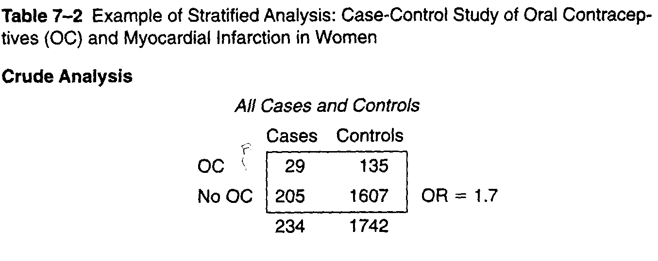

Slide 47
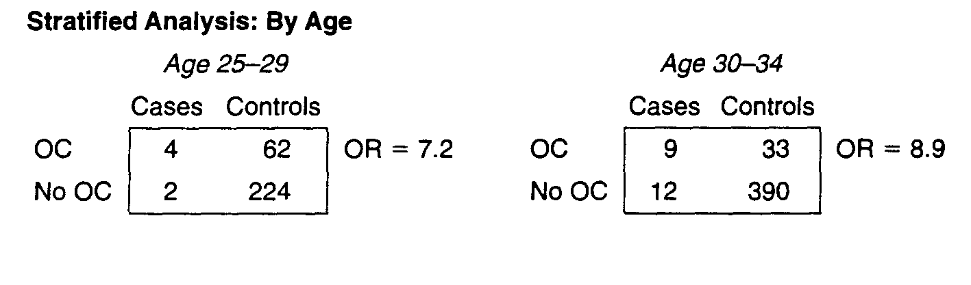

Slide 48
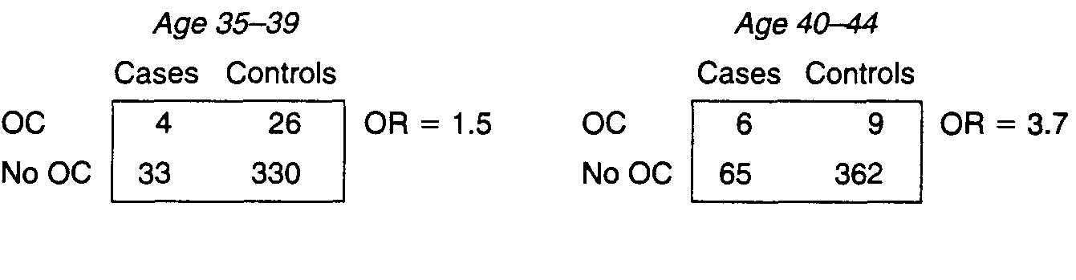
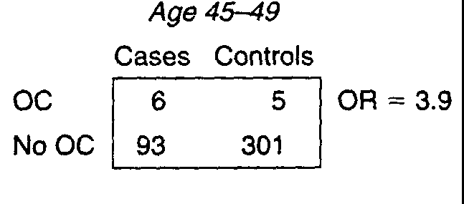

Slide 49
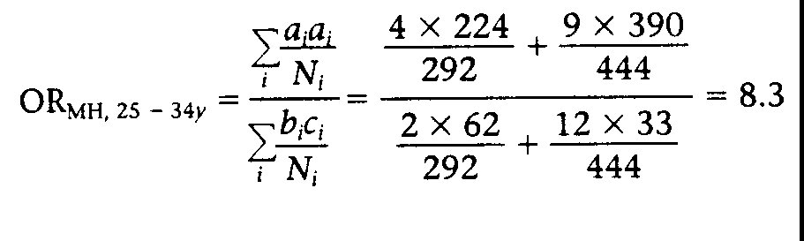
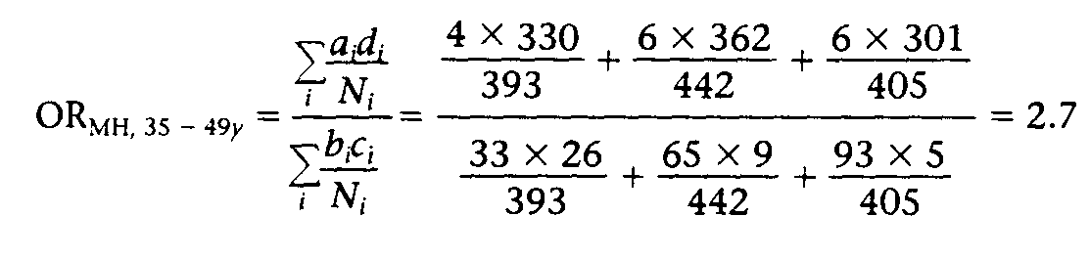

Slide 50
Approaches to Statistical Analysis and Interpretation
Non-causal explanations for an association
Observation bias
Confounding
Chance variation

Slide 51
Chance Variation
Statistical significance: probability value as large, or larger than that observed occurring by chance, given the sample size and statement of the null hypothesis.

Slide 52
Selecting a Method of Statistical Analysis
Determine type of data represented by dependent and independent variable
Types of data
continuous
ordinal
nominal

Slide 53
Methods to Derive Confidence Limits for Odds Ratios
Woolf’s method
Test-based (Miettinen)
Cornfield exact method

Slide 54
Woolf’s Method
Cases Controls T
Exp a b m1
Non-Exp c d m2
T n1 n2
Estimated
Variance = ln OR = 1/a +1/b +1/c +1/d
Combining strata into single overall estimate each ln OR is weighted by inverse of variance

Slide 55
Test-Based Confidence Limits
Used in combination with Mantel-Haenszel procedures for estimating summary relative risk and chi-square statistic
Ln ORMH (1±1.96/x)
where x=sqrt**chisq (MH)
95%CI = exponentiate [Ln ORMH (1±1.96/x)]

Slide 56
Stratification and Adjustment
Stratified according to potential confounding variable
Stratum I
Cases Controls T
Exp ai bi m1i
Non-Exp ci di m2i
T n1i n2i Ni
OR MH = Σ aidi/Ni / Σbici/Ni
Assumption: Homogeneity of effects across categories of the stratifying variable

Slide 57
Hypothesis Testing based on Stratified Data
Mantel Haenszel Chi-Square
one degree of freedom
extensionof chisquare formula for a series of 2*2 tables
Case-control study
X2MH = [Σa-Σ (a+b)(a+c)/T]2
Σ(a+b)(c+d)(a+c)(b+d)/T2(T-1)
Chi-square distribution on 1 degree of freedom is related to normal distribution

Slide 58
Mantel Haenszel Adjusted Rate Ratio
Cohort Study
Stratum I
Cases Person-time
Exp a1i y1i
Non-exp a0i y0i
Total Ti
RRMH = Σ a1iy0i/ Ti / Σa0iy0i/Ti

Slide 59
Assessing the Presence of Confounding
Is the confounding variable related to both the exposure and outcome in the study
Does the exposure-outcome association observed in the crude analysis have the same direction as and similar magnitude as the associations observed within the strata of the confounding variable

Slide 60
Does the exposure-outcome association observed in the crude analysis have the same magnitude and direction as the association observed after adjusting for the confounding variable?
E.g. % excess risk explained by confounding variable = RRu - RRa / RRu -1.0 * 100

Slide 61
Defining and Assessing Heterogeneity of Effects Interaction
For dichotomous variables, effect of exposure variable on outcome differs depending on whether another variable (the effect modifier) is present
positive interaction -synergy
negative interaction-antagonistic
For continuous variables: the effect of exposure variable on outocme differs depending on level of effect modifier

Slide 62
In stratification analysis : heterogeneity in odds ratios (RRs) across strata as a result of interaction between exposure, risk factor and stratum specific third variable

Slide 63
Assessment of Interaction in Case-Control Studies
Assessment of Homogeneity of the effects
In a case-control study, the homogeneity strategy can be used to assess the presence or absence of multiplicative interaction
Absolute measures of disease risk are usually not available in case-control studies; not possible to measure absolute difference between exposed and unexposed
Homogeneity of effects is based on odds ratio

Slide 64
However, it is possible to assess additive interaction in a case-control study by using the strategy of comparing observed and expected joint effects

Slide 65
Comparing Observed and Expected Joint Effects: Case-Control Study
Independent effects of A (exposure) and Z (third variable) are estimated in order to compute expected joint effect
Compare observed joint effect
When observed and expected joint effects differ, interaction is said to be present

Slide 66
Comparing Observed and Expected Joint Effects
Assessing the heterogeneity of effects: Case-Control Studies
What is measured? Exp Z Exp A Cases Controls OR
reference No No A-Z- 1.0
Indpt effect of A No Yes A+Z-
Indpt effect of Z Yes No Z+A-
Observed Joint Effect Yes Yes A+Z+

Slide 67
Detection of Additive Interaction: Case-Control Study
Because incidence data usually not available, important to use equations based on odds ratios. Thus:
baseline OR=1.0
baseline+excess due to A
baseline+excess due to Z
expected joint OR based on adding absolute independent excesses due to A and Z
Observed joint OR > Expected OR interaction based on additive model

Slide 68
Expected OR A+Z+ = 1.0 (ObsORA-Z+ - 1.0) + (Obs.ORA-Z+ -1.0)
When OR associated with factors A and Z are less than one (<1.0) the formula to estimate the expected joint additive effect is
Expected OR A+Z+ = 1.0/ (1.0/ORA+Z- + 1.0/ORA-Z+ -1.0)
On an additive scale in the absence of interaction, the effect of A in the presence of Z is the same as the effect of A in the absence of Z

Slide 69
Detection of Multiplicative Interaction: Case-control Study
Expected joint odds ratios is estimated as the product of the independent ORs
No interaction
Exp ORA+Z+ =ObsORA-Z+ * ObsORA+Z-
Note: in assessing either additive or multiplicative interaction, determination cannot be made on a matched variable and another risk factor. Independent effect of matched variable cannot be determined.

Slide 70
Evaluation of Interaction in Matched Case-Control Studies
Smoking as the matched variable and Alcohol as exposure of interest
Scale Analysis Information Feasibility Why?
Additive Homogeneity AR for alcohol No AR not
of effects use by smoking available
Multiplicative O vs E joint ORs expressing No ORs not
effects independent available
effects of smoking
and alcohol
Multiplicative homogeneity OR’s for alcohol Yes ORs
of effects according to smoking available

Slide 71
When a variable is found to be both a confounding variable and an effect modifier, adjustment or averaging for this variable is not appropriate.

Slide 72
If the sample size is very large, an interaction of small magnitude may be statistically significant but devoid of scientific or public health significance

Slide 73
Test of Homogeneity of Stratified Estimates
Test for interaction across strata due to:
random variability
confounding (differential confounding) effects according to strata
bias (differential bias across strata)
effect modification (biologic, mechanistic significance

Slide 74
Test of Homogeneity of Stratified Estimates
k strata
Ho: strength of association is homogeneous across strata
compare with log rank test used in stratified survival analysis:
X2 k-1 = Σ (ORi - OR)2 / Vi
where ORi = stratum specific OR
i = 1 to k strata
Vi = stratum specific variance
OR = estimated “common’ measure of association under the null hypothesis. May be based on weighted averages of stratum-specific estimates of association, Mantel-Haenszel summary OR.
Degrees of freedom k-1 (Appears in SAS as Breslow-Day statistic

